Slide 1
MIS-5 END TERM PROJECT TEAM - 2

Slide 2
TEAM
1 | Aman Sirohi | CB.EN.U4AIE21003
2 | R Sriviswa | CB.EN.U4AIE21046
3 | Rakhil ML | CB.EN.U4AIE21048
4 | Vikhyat Bansal | CB.EN.U4AIE21076

Slide 3
Constructing a CNN model using the Bayesian approach. Ultimately, we will be able to deduce how the architecture and inferences made by the Bayesian CNN when predicting images are different from those of the standard CNN.
The actions that we will take in this post are listed below:
Obtaining the image dataset
Developing a conventional CNN model
The Bayesian CNN model's creation

Slide 4
About the Dataset
For the data, we’re going to use the flowers dataset that you can freely download on Kaggle. This data contains a collection of five different types of flowers: daisy, dandelion, tulip, rose, and sunflower. The main goal is to classify which flower belongs to which type.
In total, there are 4242 images of flowers, where there are about 800 images of flowers in each type.

Slide 5
Loading the Data
flowers/
daisy/
img1.jpg
img2.jpg
…
rose/
img19.jpg
img20.jpg
…
The flowers folder doesn’t contain separate files for training data and test data. Hence, we need to make one ourselves.

Slide 6
We want to split the folder into a training folder and test folder such that we have the following format:
flowers/
train/
daisy/
img1.jpg
...
sunflower/
imga.jpg
...
test/
daisy/
img3.jpg
...
sunflower/
imgc.jpg
...

Slide 7
How do we split the Folders?
To split the folder into a training and test folder, we can use a python library called split-folders.
We can install the library using the command:
pip install split-folders
import os
import splitfolders
input_dir = os.path.join("flowers/")
output_dir = os.path.join("flowers_splitted/")
splitfolders.ratio(
input_dir, output=output_dir, seed=1337, ratio=(0.8, 0.2), group_prefix=None
)
This way we assign 80% of the data for training and rest 20% for testing.

Slide 8
Assigning Training and Testing Data
train_dir = os.path.join("flowers_splitted/train/")
test_dir = os.path.join("flowers_splitted/val/")

Slide 9
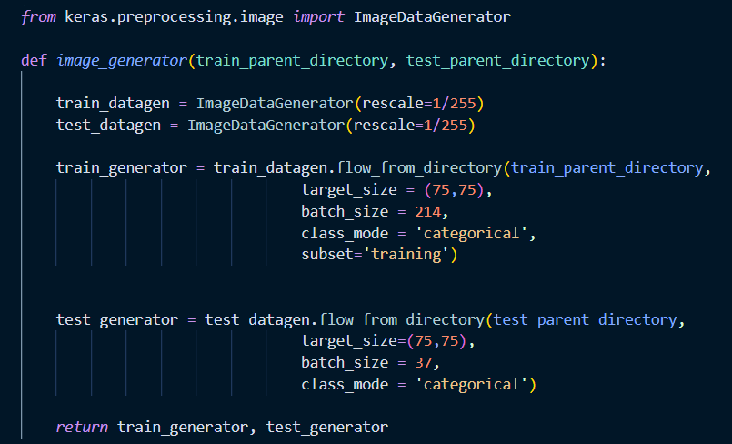
We can use image generator from TensorFlow to generate training and test data as well as to automate the labelling process of our images.

Slide 10
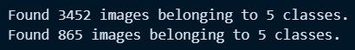
Now we can call the function above to generate our training and test set by passing the variables train_dir and test_dir that we have defined earlier.
Now, we have loaded the data, and we can proceed to build an image classification model, both with standard CNN and with Bayesian CNN.

Slide 11
01
IMAGE CLASSIFICATION USING CNN

Slide 12
Convolutional Neural Networks
Convolutional neural networks are deep artificial neural networks. We use CNN to classify images, cluster them by similarity (photo search), and perform object recognition within scenes.
It can be used to identify faces, individual, street signs, tumors, platypuses and many other aspects of visual data. The convolutional layer is the core building block of a CNN.
The layer’s parameters consist of a set of learnable filters (or kernels) which have a small receptive field but extend through the full depth of the input volume. During the forward pass, each filter is convolved across the width and height of the input volume, computing the dot product, and producing a 2-dimensional activation map of that filter.
As a result, the network learns about the filters. The filter activates when they see some specific type of feature at some spatial position in the input. Then the activation maps are fed into a down sampling layer, and like convolutions, this method is applied one patch at a time.
CNN has also fully connected layer that classifies output with one label per node.

Slide 13
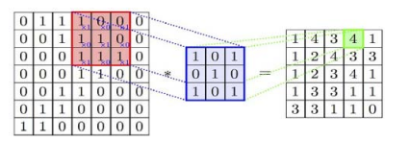
CONVOLUTION OPERATION
The initial layer from which features can be extracted from the images is the convolutional layer.
Because pixels are only related to the adjacent and close pixels, convolution allows us to preserve the relationship between different parts of an image.
Convolution is filtering the image with a smaller pixel filter to decrease the size of the image without losing the relationship between pixels. When we apply convolution to a 7x7 image by using a filter of size 3x3 with 1x1 stride (1-pixel shift at each step), we will end up having a 5x5 output.

Slide 14
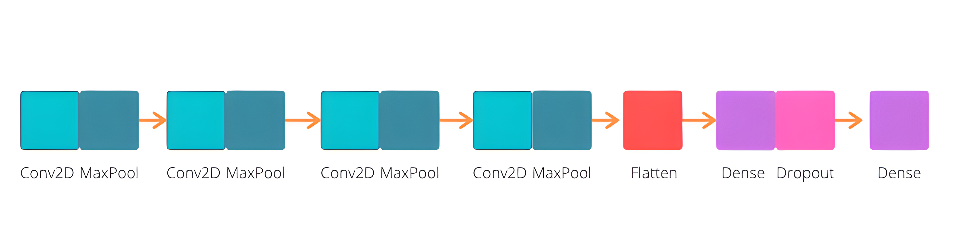
Approach
To build the model, we’re going to use standard CNN with TensorFlow. The model consists of four convolutional layers before we flatten it and use a dense layer at the very end.

Slide 15
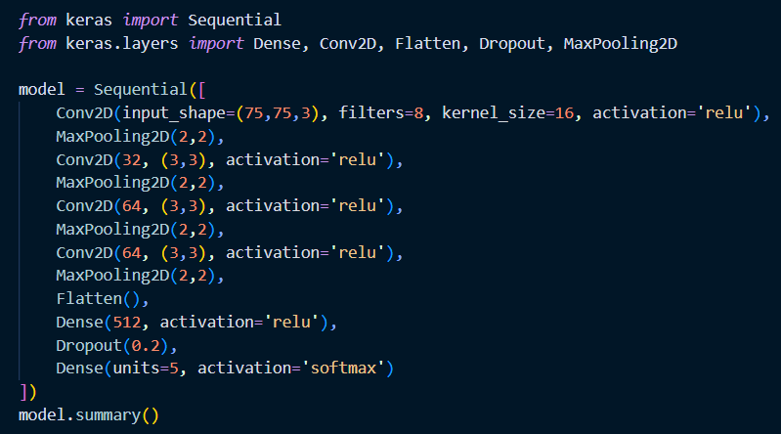
Code

Slide 16
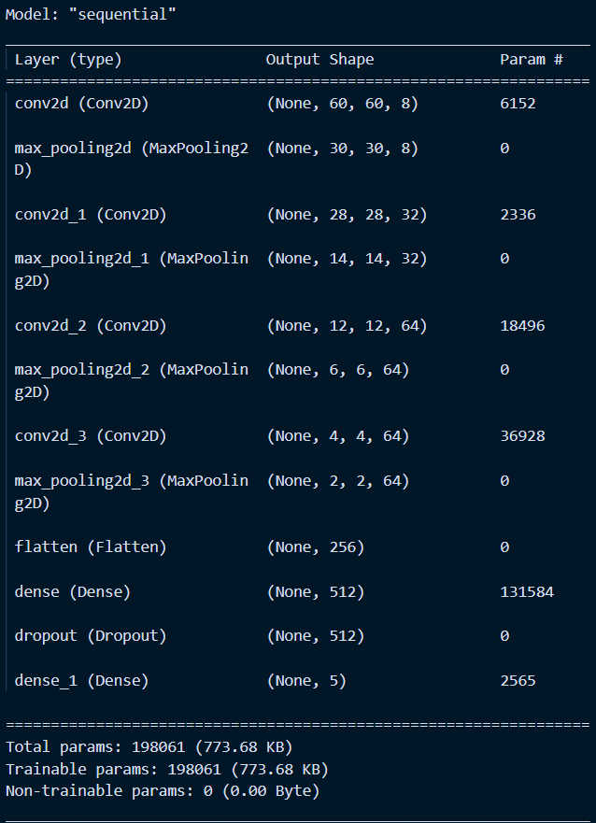
Output
The model in total has 198,061 parameters, with 6152 parameters at the beginning and 2565 at the end. We’re going to compare these parameters with the Bayesian model later.

Slide 17
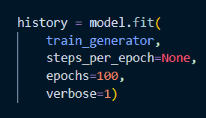
Now, we need to compile the model. We have used Adam optimizer for the model. As the problem is a classification problem, we need to use categorical cross-entropy as the loss function. Finally, accuracy metrics was used.
After compiling the model, now we can start to train the model. The model will be trained in total for 100 epochs, since 100 epochs will be enough for the loss function to converge. After training the model, we can alternatively save the trained model.

Slide 18
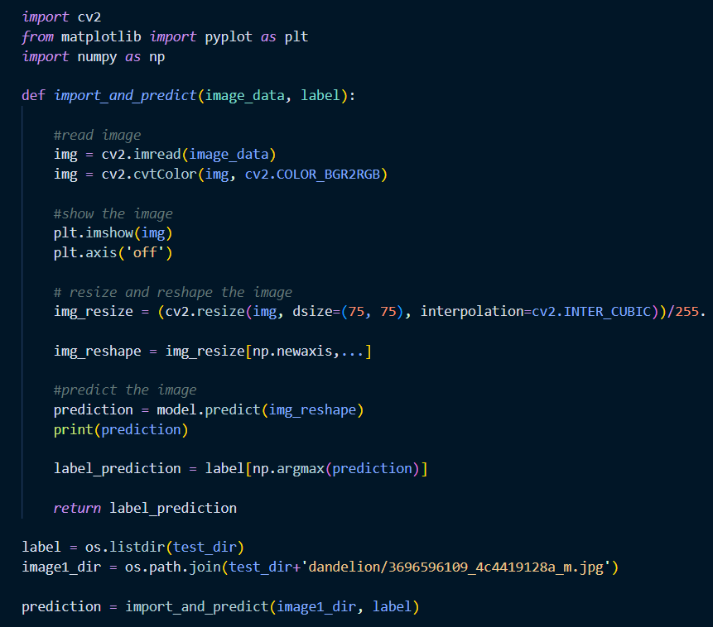
Finally, we can now make a prediction based on images in our test set with the trained model. We have created a function to preprocess the image that we want to predict and then assign the model to make a prediction based on that image.
Prediction

Slide 19
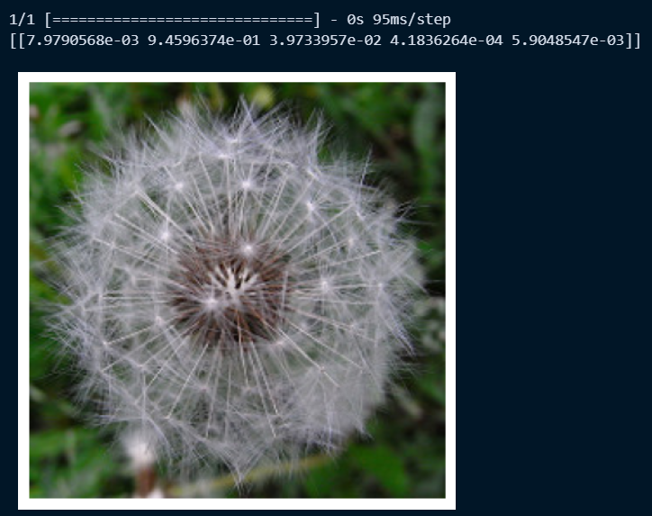
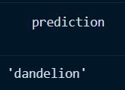
Output
The model predicts with 0.999 probability that our image belongs to a dandelion class. This means that our model is very certain

Slide 20
Observation
This is the basic image classification model using the standard CNN architecture. The model looks great in the sense that it correctly predicts two of our images from the test set with a high probability.
However, what we don’t know is how certain is our model in assigning that 0.999 probability value on each of our images. Is the model really confident to assign that 0.999 probability value to our images? We also don’t know if the model knows what it doesn’t know.
We can’t answer all the points above with standard CNN. That’s why we need to build a CNN model from a Bayesian perspective. Next, we are building a CNN model based on a Bayesian perspective.

Slide 21
01
IMAGE CLASSIFICATION USING BAYESIAN CNN

Slide 22
Image classification using Bayesian Convolutional Neural Networks (BCNNs) represents a cutting-edge approach to address challenges inherent in limited labelled data scenarios.
Traditional deep learning models, particularly convolutional neural networks (CNNs), face difficulties with overfitting when confronted with sparse training datasets.
In response to this, BCNNs introduce Bayesian principles by incorporating probability distributions into the model parameters. This innovative approach not only enhances the robustness of the model against overfitting but also provides a unique capability to quantify uncertainty.
In image classification tasks, where acquiring labelled data can be expensive or impractical, BCNNs demonstrate a remarkable advantage. Experimental evidence suggests that BCNNs can outperform traditional CNNs in such scenarios, showcasing their efficacy in handling the data scarcity challenge.
Moreover, the uncertainty measures offered by BCNNs, including aleatoric and epistemic uncertainties, contribute to a more nuanced understanding of the model's predictions. This uncertainty-aware nature of BCNNs finds practical implications in various real-world applications, such as remote sensing and medical image analysis.
One notable aspect of BCNNs is their remarkable capacity for model compression, making them particularly well-suited for deployment in hardware-constrained environments.
This attribute holds significance for applications on devices with limited memory or processing capabilities, allowing BCNNs to maintain high performance even in resource-constrained settings.

Slide 23
Furthermore, BCNNs introduce a novel approach to misclassification detection by leveraging uncertainty measures. The ability to identify misclassified samples based on uncertainty provides enhanced model interpretability, a crucial consideration for applications where model predictions have significant consequences.
Addressing challenges related to computational efficiency and scalability remains an open area for future investigation. In summary, image classification using Bayesian CNNs presents a promising and versatile framework, offering solutions to critical issues related to data scarcity, overfitting, and uncertainty in practical applications.

Slide 24
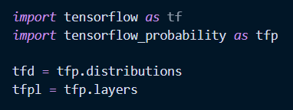
To build a Bayesian CNN, we need to first import the necessary libraries. In this article, we’re going to use TensorFlow Probability library to create the first and the last layers of our neural networks model. We can install the python library using the command: pip install tensorflow-probability We will start by importing the necessary libraries to our environment.

Slide 25
Approach
The architecture will be the same as the standard CNN model that we’ve built before. So, it has four convolutional layers before we flatten it and use a dense layer at the very end.
The differences between the classic CNN and this model are the first convolutional layer and the last dense layer of the model.
The first layer we are using is The Convolutional2DReparameterization Layer
And the last dense layer of this model is The DenseReparameterization Layer.

Slide 26
The Convolutional2DReparameterization Layer
For the first convolution layer, instead of using a normal CNN Conv2D layer, we are going to use Convolutional2DReparameterization layer. The point of this layer is to take aleatoric uncertainty into account, which is the uncertainty that arises from the quality of the data. So, instead of creating an output of the same deterministic value as a standard CNN does, it will create an output that is drawn from a distribution.
Because this layer creates an output from a distribution, then we need to define several things here as the argument:
Prior for kernel and bias parameters
Posterior for kernel and bias parameters
Kullback-Leibler divergence

Slide 27
The DenseReparameterization Layer
If the Convolutional2DReparameterization layer in the beginning is to take aleatoric uncertainty into account, this DenseReparameterization layer is applied to take epistemic uncertainty into account. Epistemic uncertainty is the uncertainty that arises from the model itself.
To apply this layer, we need to pass the same arguments as in Convolutional2DReparameterization layer: the kernel prior and posterior, the bias prior and posterior, as well as the divergence function for KL divergence. As an output, we’re going to pass this dense layer to a final one hot categorical layer consists of 5 units, as we have 5 classes in our flowers classification.

Slide 28
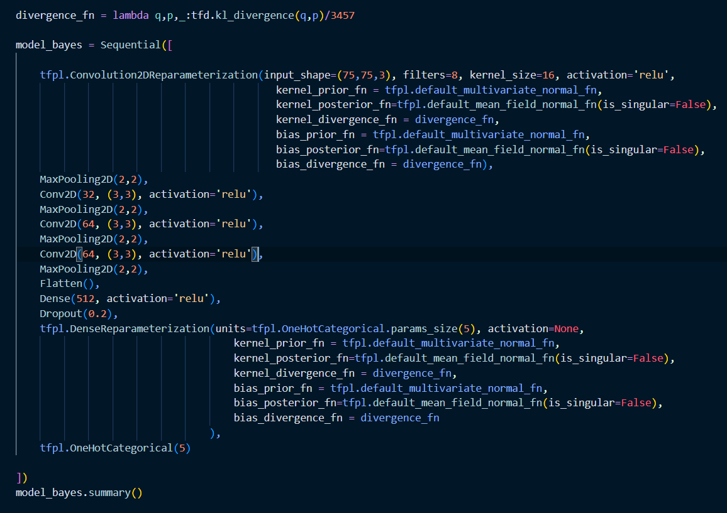
Code

Slide 29
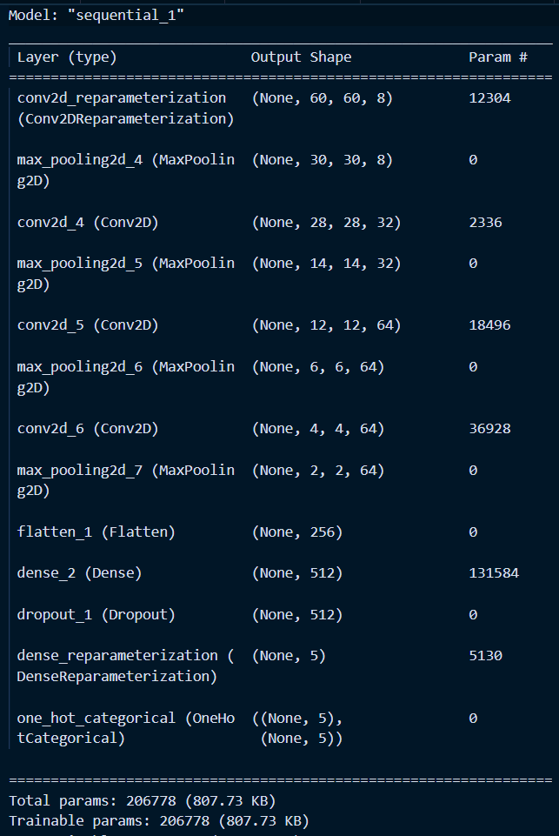
Output
In the model summary that we have generated from our Bayesian CNN, we can see that at the first convolutional layer and the last dense layer, the number of parameters is twice as many as the parameters in the standard CNN model.
This is because we have changed the weight of parameters from a single deterministic value into a value that is drawn from a distribution. Since we used a normal distribution, then it has two parameters instead of just one: the mean and the standard deviation.

Slide 30
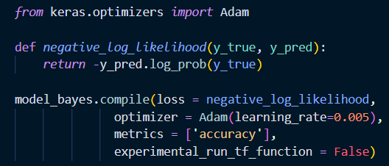
Compile
We are using Adam optimizer, and the metrics is the model’s accuracy. However, we’re using a negative log-likelihood as our loss function for our Bayesian CNN model to maximize the likelihood estimate of the mean and the standard deviation of the weights.

Slide 31
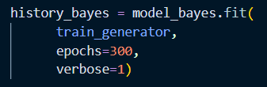
Training
Now we are ready to train our model. For this Bayesian CNN, we’re going to train the model for 300 epochs, since the model is more complicated than our standard CNN model.

Slide 32
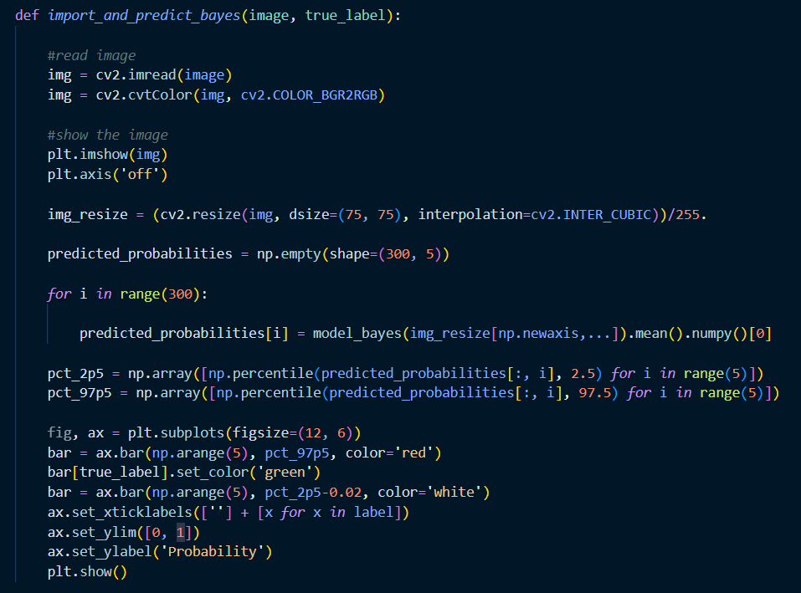
Prediction

Slide 33
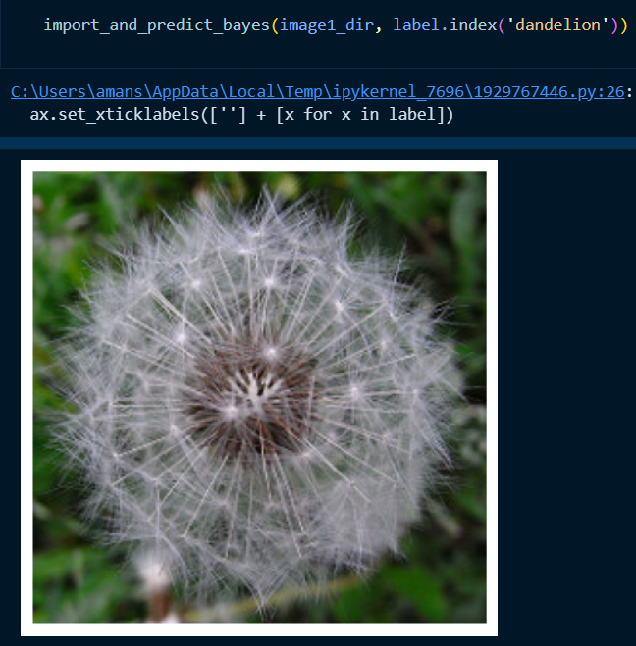
Output
As you can see above, our model correctly predicts that our image is a dandelion with a very high probability value, which is ~1.0. Not only it predicts our image as dandelion with ~1.0 probability, but it also assigns the ~1.0 probability value with an absolute certainty, which is great.

Slide 34
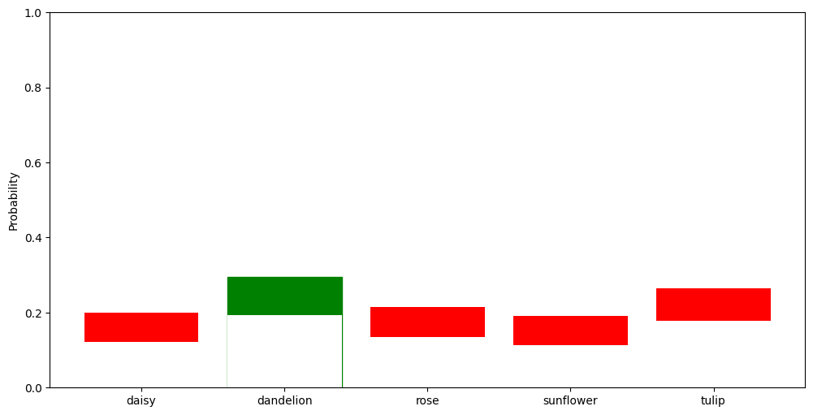

Slide 35
Conclusion
When we tried predicting for a Rose Image, we observed that:
With our previous standard CNN, our model predicts correctly that our image is a rose, with 0.999 probability value. That looks great. However, when you look at the result from our Bayesian CNN model above, the aleatoric and epistemic uncertainty actually exist when predicting our rose image:
The aleatoric uncertainty is shown as the model also assigns a high probability value for the dandelion class.
The epistemic uncertainty is shown as the model itself is not certain how big of a probability value that it should assign in each of the flower classes.
.
As mentioned earlier, we’re assigning the model to predict our rose image 300 times instead of just once. Of those 300 predictions, in one run the model may predict our image as a rose with 0.1 probability and dandelion with 0.8 probability. In another run, it may predict our image as a rose with 1.0 probability and dandelion with 0 probability. The variability of probability value is huge in our CNN model.
With this epistemic uncertainty, our CNN model basically knows what it doesn’t know. It demands us to supply more variations in training data in order for it to classify our rose image with better certainty, like the one with dandelion image. Overall, epistemic uncertainty can be reduced by supplying more training data to the model.

Slide 36
02
IMAGE CLASSIFICATION USING DMD BASED FEATURE EXTRACTION

Slide 37
It is basically a modal decomposition algorithm which gives insight into the underlying dynamics of the system. The key feature of DMD algorithm is its ability to extract both spatial and temporal patterns of the data where existing methods are restricted to either of the patterns.​
The DMD (dynamic mode decomposition) is a mathematical method, which is a data-driven matrix decomposition. It can provide accurate reconstructions of spatio-temporal coherent structures​ arising in nonlinear dynamical systems. ​
​
Dynamic Mode Decomposition (DMD) introduces a novel perspective to image classification by extracting features that capture the inherent dynamics within static images.
In contrast to traditional approaches, which often rely on extensive labeled datasets, DMD provides a mechanism to uncover temporal structures within images.
By inducing flow through color space transformations and employing DMD, this method effectively translates static images into dynamic representations, allowing for a more nuanced understanding of their underlying patterns.
This dynamic approach holds promise for scenarios where labeled data is limited, offering a valuable alternative in the realm of image classification methodologies.

Slide 38
DMD FOR IMAGE CLASSIFICATION
Image Preprocessing: Prepare your dataset of flower images. Resize them to a consistent size, convert them to grayscale or RGB format as required, and ensure they're appropriately labelled.
DMD Feature Extraction: Apply DMD to extract relevant features from these images. DMD will decompose the images into a set of spatial modes that capture the most important features.
Classifier Training: Use the features obtained from DMD as inputs to a classification algorithm (e.g., SVM, Random Forest, etc.) to train a model for flower classification.

Slide 39
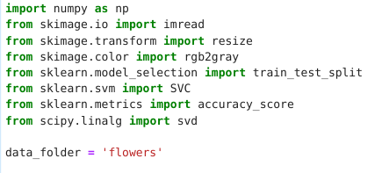
CODE

Slide 40
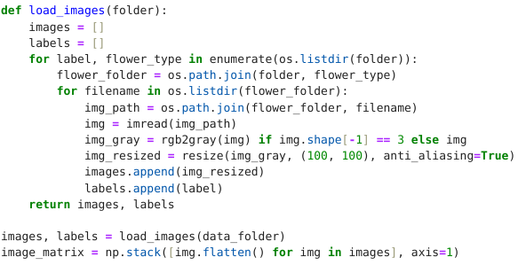

Slide 41
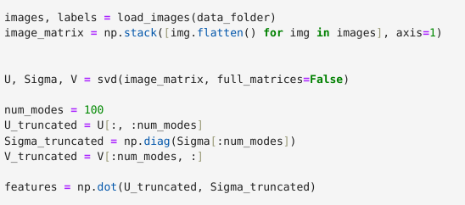

Slide 42
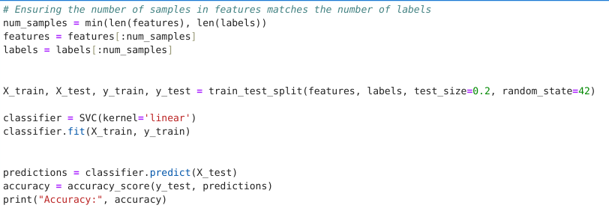

Slide 43
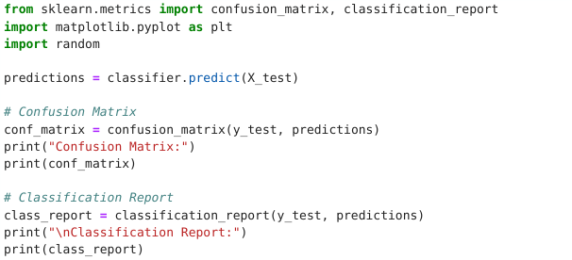
EVALUATION

Slide 44
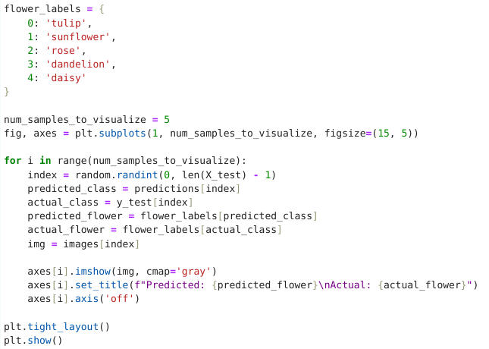

Slide 45
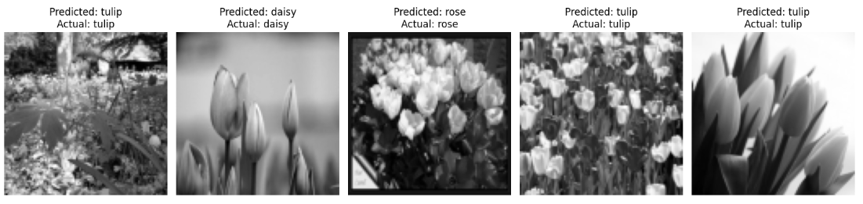
RESULTS

Slide 46
03
IMAGE CLASSIFICATION USING BNN

Slide 47
A Bayesian Neural Network (BNN) is a type of neural network that incorporates Bayesian principles to model uncertainty in its parameters.
In a traditional neural network, the weights are fixed values learned from the training data. In contrast, a Bayesian Neural Network treats the weights as probability distributions, allowing it to express uncertainty about the true values of the weights.
A typical BNN for image classification has a similar architecture to a standard neural network, consisting of input layers, hidden layers, and an output layer.
The output layer of the BNN produces a probability distribution over the possible classes. This is achieved using a softmax activation function, which converts the network's raw output into class probabilities.
For each class, the BNN outputs a probability distribution instead of a single probability value.
BNNs model uncertainty through the introduction of prior and posterior distributions over the network weights.
During training, Bayesian inference techniques are employed to update the prior distribution based on the observed data. This involves calculating the posterior distribution, which represents the updated belief about the weights given the data.

Slide 48
The loss function used during training includes not only the standard classification loss (e.g., cross-entropy) but also a term related to the Kullback-Leibler (KL) divergence. The KL divergence measures the difference between the prior and posterior distributions of the weights, acting as a regularization term.
Training a BNN involves minimizing the combined loss function, which includes the classification loss and the regularization term (KL divergence).
Stochastic Gradient Descent (SGD) or other optimization algorithms are used to update the weights.
During inference, the BNN provides not just a point estimate of the class but a full probability distribution over classes.
Uncertainty can be quantified by examining the spread or entropy of the predicted probability distribution. High uncertainty may indicate ambiguous or challenging-to-classify instances.
Model performance is evaluated using standard classification metrics such as accuracy, precision, recall, and F1 score.
Bayesian Neural Networks find applications in image classification scenarios where understanding model uncertainty is crucial, such as in medical imaging, safety-critical systems, or scenarios with limited labeled data.

Slide 49
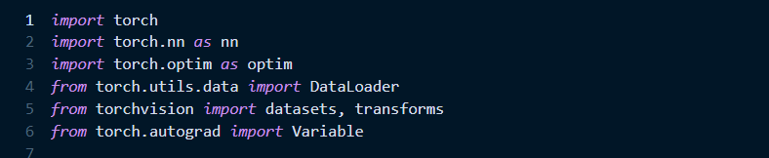

Slide 50
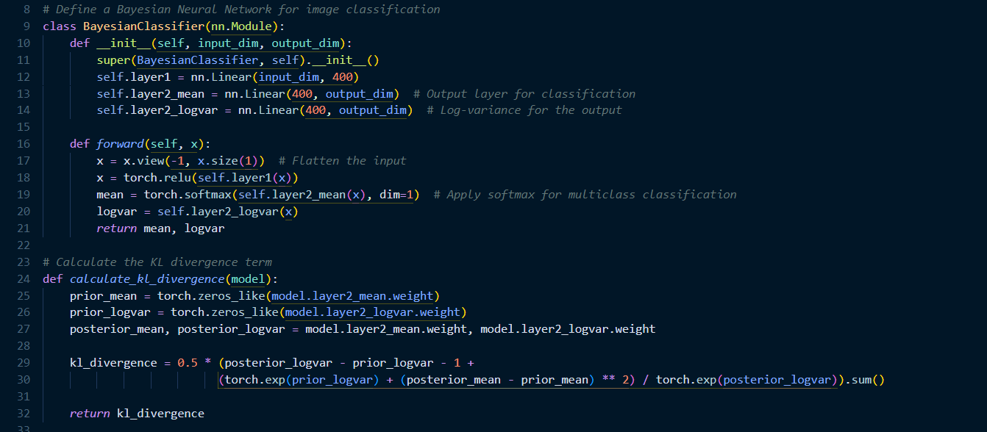

Slide 51
In the `__init__` method, the class first calls the initializer of the superclass with `super(BayesianClassifier, self).__init__()`. It then defines three layers: `layer1`, `layer2_mean`, and `layer2_logvar`. `layer1` is a linear layer with `input_dim` inputs and 400 outputs. `layer2_mean` and `layer2_logvar` are both linear layers with 400 inputs and `output_dim` outputs. `layer2_mean` is used to output the mean of the prediction for each class, while `layer2_logvar` is used to output the log-variance of the prediction for each class. In the `forward` method, the class first reshapes the input `x` to a 2D tensor with `x.view(-1, x.size(1))`. It then applies the ReLU activation function to the output of `layer1`. The outputs of `layer2_mean` and `layer2_logvar` are then computed. The output of `layer2_mean` is passed through a softmax function to ensure the sum of probabilities for all classes is 1, suitable for multi-class classification. The outputs of `layer2_mean` and `layer2_logvar` are then returned. In summary, this class represents a Bayesian Neural Network with one hidden layer and two output layers for mean and log-variance. It uses the ReLU activation function for the hidden layer and the softmax function for the mean output layer.
The code defines a function `calculate_kl_divergence` that calculates the Kullback-Leibler (KL) divergence between the prior and posterior distributions of the weights in a Bayesian Neural Network model. KL divergence is a measure of how one probability distribution diverges from a second, expected probability distribution.The function takes one argument, `model`, which is an instance of a Bayesian Neural Network model. The model is expected to have attributes `layer2_mean` and `layer2_logvar` representing the mean and log-variance of the posterior distribution of the weights.The function first defines `prior_mean` and `prior_logvar` as tensors of zeros with the same shape as `model.layer2_mean.weight` and `model.layer2_logvar.weight` respectively. This implies that the prior distribution is a standard normal distribution (mean 0, variance 1).Next, it defines `posterior_mean` and `posterior_logvar` as the weights of `model.layer2_mean` and `model.layer2_logvar` respectively. These represent the mean and log-variance of the posterior distribution of the weights. The result is summed over all elements to give a scalar KL divergence.Finally, the function returns the calculated KL divergence. This value can be used as a regularization term in the loss function during training of the Bayesian Neural Network, to encourage the posterior distribution to stay close to the prior.

Slide 52
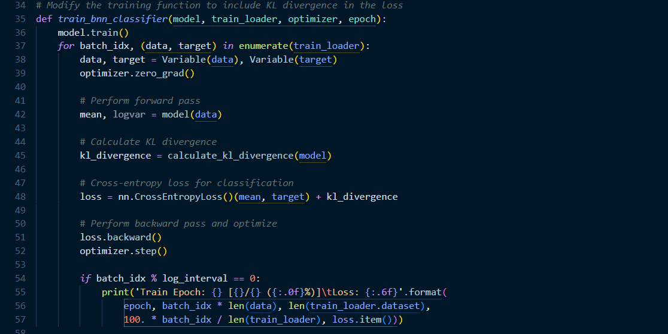

Slide 53
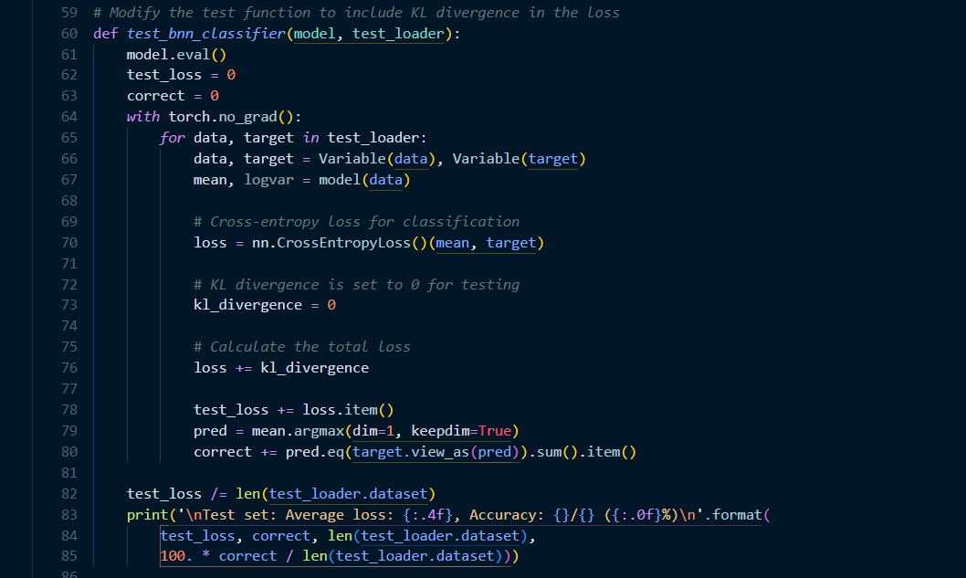

Slide 54
The code defines a function `train_bnn_classifier` that trains a Bayesian Neural Network (BNN) model for classification. This function is designed to be called for each epoch during the training process.The function takes four arguments: `model` (the BNN model to be trained), `train_loader` (a data loader that provides batches of training data and corresponding targets), `optimizer` (the optimization algorithm to be used for training), and `epoch` (the current epoch number).The function first sets the model to training mode with `model.train()`. This is important for layers like dropout and batch normalization which behave differently during training and evaluation.Next, the function enters a loop over all batches of data and targets provided by `train_loader`. For each batch, it wraps the data and targets in PyTorch `Variable` objects, which allow automatic differentiation. It then sets the gradients of all model parameters to zero with `optimizer.zero_grad()`, in preparation for a new round of gradient computation.The function then performs a forward pass through the model with `model(data)`, obtaining the mean and log-variance of the model's predictions. It calculates the Kullback-Leibler (KL) divergence between the prior and posterior distributions of the model weights with `calculate_kl_divergence(model)`. This KL divergence is used as a regularization term to encourage the model to stay close to the prior distribution.The function then calculates the loss as the sum of the cross-entropy loss between the model's predictions and the targets, and the KL divergence.The function then performs a backward pass to compute gradients with `loss.backward()`, and updates the model parameters with `optimizer.step()`.Finally, if the current batch index is a multiple of the log interval, the function prints the current epoch, the progress of the current batch, and the current loss. This provides a way to monitor the training process.
The selected Python code defines a function `test_bnn_classifier` that evaluates a Bayesian Neural Network (BNN) model on a test dataset. This function is designed to be called after the model has been trained.The function takes two arguments: `model` (the BNN model to be evaluated) and `test_loader` (a data loader that provides batches of test data and corresponding targets).The function first sets the model to evaluation mode with `model.eval()`. This is a standard practice in PyTorch, which allows the model to know that it's in evaluation mode. Next, the function initializes `test_loss` and `correct` to 0. `test_loss` will accumulate the total loss on the test dataset, and `correct` will count the number of correctly classified samples.The function then enters a loop over all batches of data and targets provided by `test_loader`. For each batch, it wraps the data and targets in PyTorch `Variable` objects, which allow automatic differentiation. It then performs a forward pass through the model with `model(data)`, obtaining the mean and log-variance of the model's predictions.The function then calculates the cross-entropy loss between the model's predictions and the targets using PyTorch's `nn.CrossEntropyLoss()` function. Note that the KL divergence is set to 0 during testing, as it's only used as a regularization term during training.The function then updates `test_loss` with the current loss, and computes the model's predictions by taking the argmax of the mean over dimension 1. It updates `correct` by comparing the model's predictions with the targets, summing the number of correct predictions.After the loop, the function calculates the average test loss by dividing `test_loss` by the number of samples in the test dataset. It then prints the average test loss and the accuracy (the percentage of correctly classified samples).In summary, this function evaluates a BNN model on a test dataset, calculates the cross-entropy loss and accuracy, and prints the results.

Slide 55
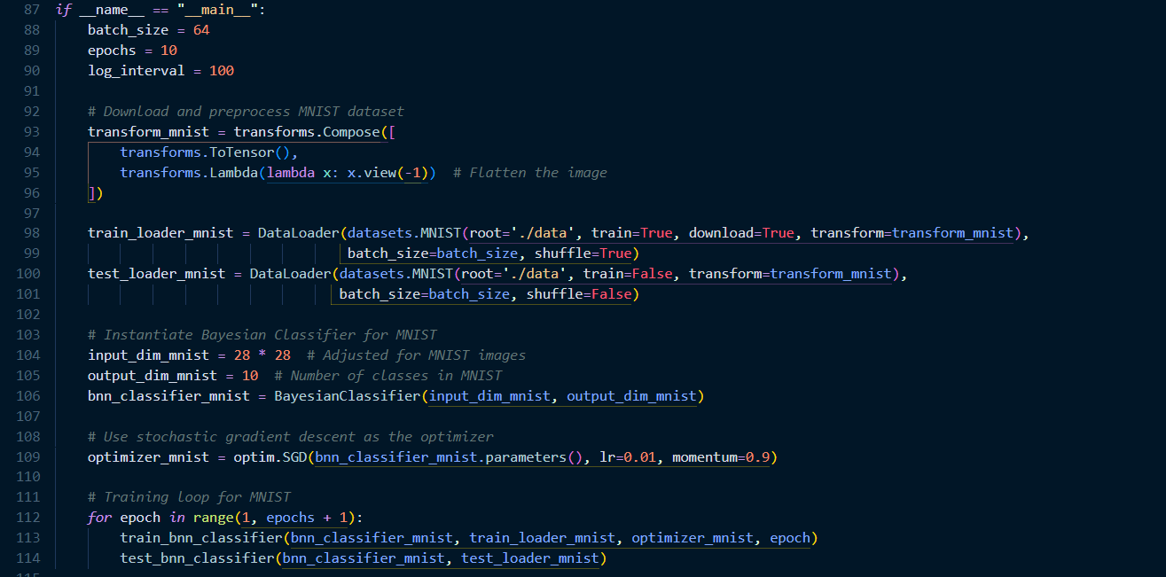

Slide 56
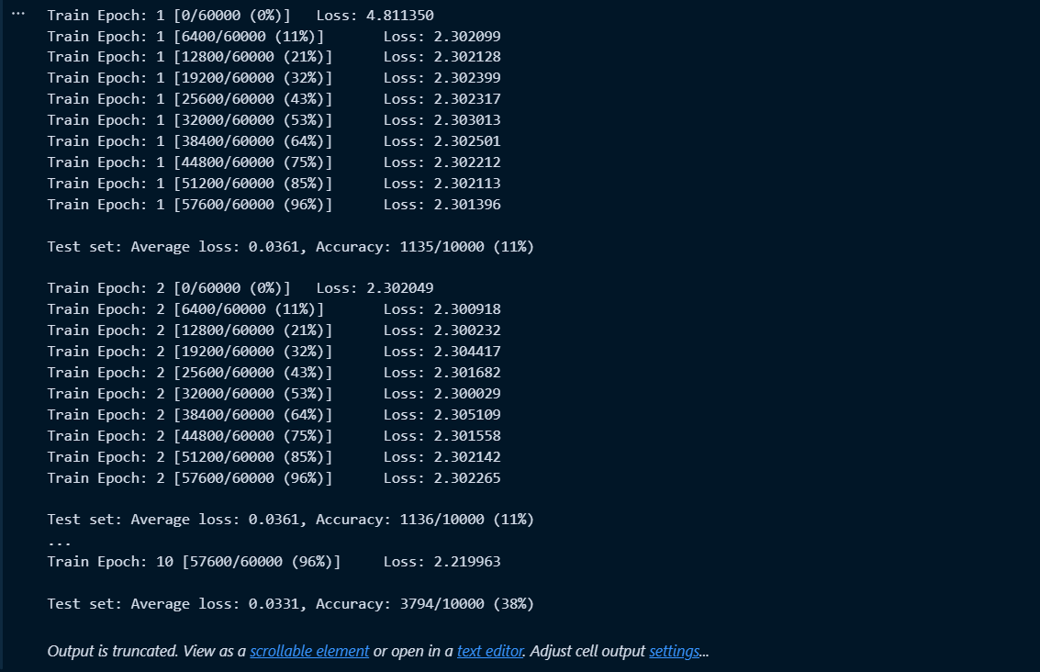
Training the data

Slide 57
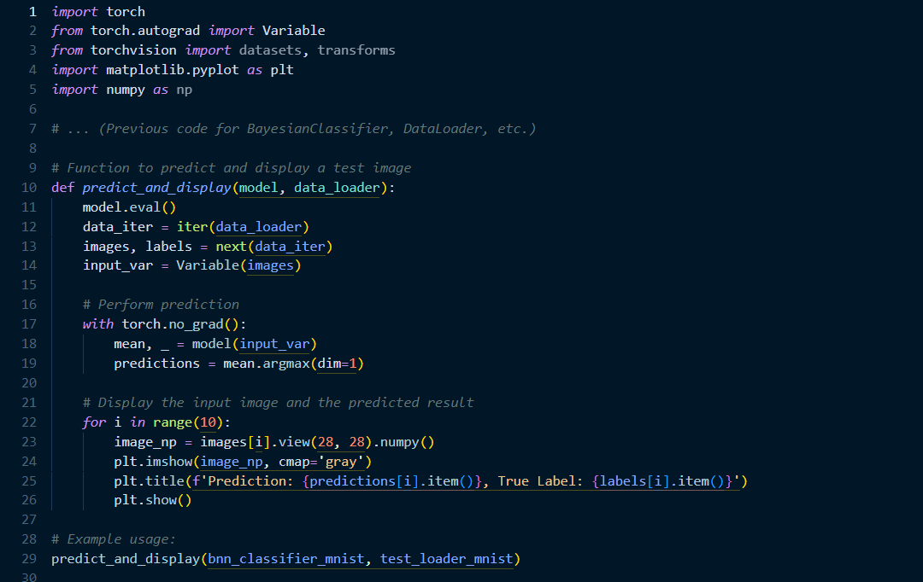

Slide 58
The Python code defines a function `predict_and_display` that uses a trained model to make predictions on a batch of data and then displays the input images along with the predicted and true labels.The function takes two arguments: `model` (the trained model) and `data_loader` (a data loader that provides batches of data).The function first sets the model to evaluation mode with `model.eval()`. This is a standard practice in PyTorch, which allows the model to know that it's in evaluation mode. This is important for layers like dropout and batch normalization which behave differently during training and evaluation.Next, the function creates an iterator from the data loader with `iter(data_loader)`. It then uses the `next` function to get the next batch of images and labels from the data loader. The images are wrapped in a PyTorch `Variable` object, which allows automatic differentiation.The function then performs a forward pass through the model with `model(input_var)`, obtaining the mean and ignoring the log-variance of the model's predictions. The predictions are obtained by taking the argmax of the mean over dimension 1.The function then enters a loop to display the first 10 images in the batch along with their predicted and true labels. For each image, it reshapes the image to a 2D array and converts it to a numpy array. It then uses matplotlib's `imshow` function to display the image in grayscale, and `title` function to display the predicted and true labels above the image. The `show` function is used to display the figure.In summary, this function uses a trained model to make predictions on a batch of data, and displays the input images along with the predicted and true labels.

Slide 59
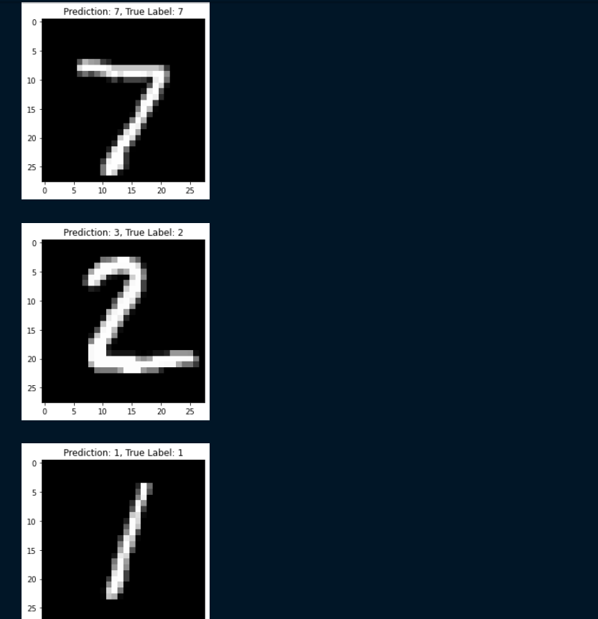
Output Based on MNIST Dataset

Slide 60
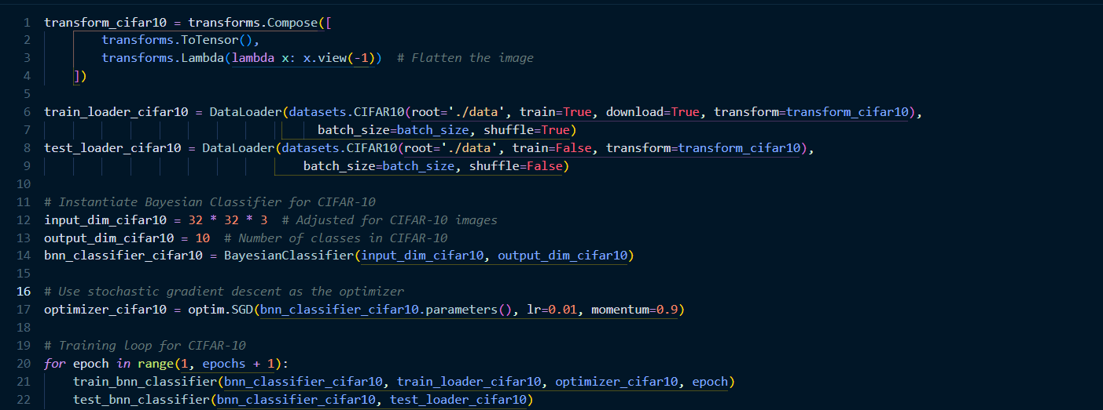
Code Based on CIFAR-10 Dataset

Slide 61
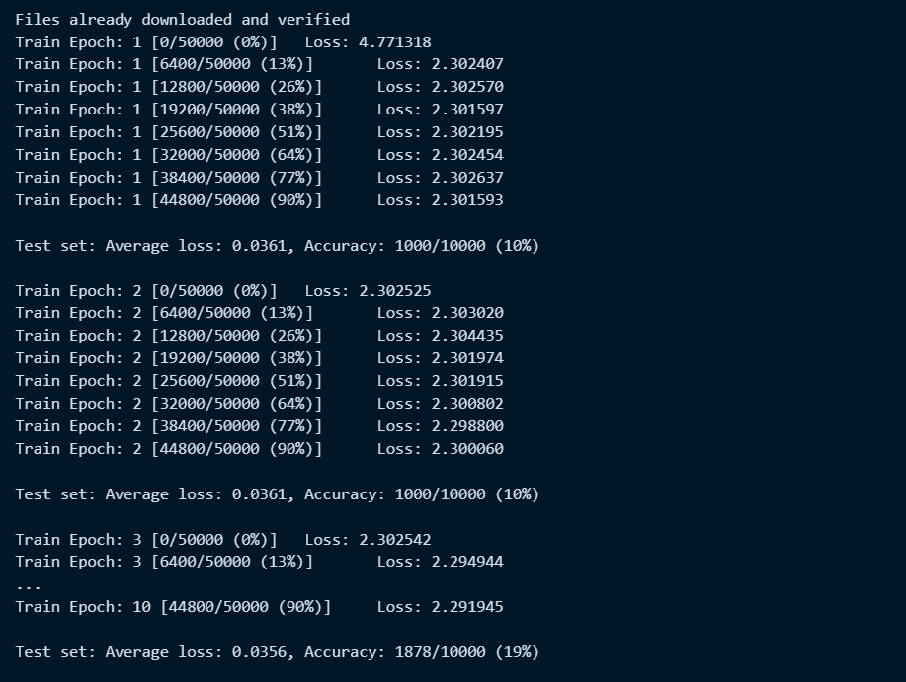
Output Based on CIFAR-10 Dataset

Slide 62
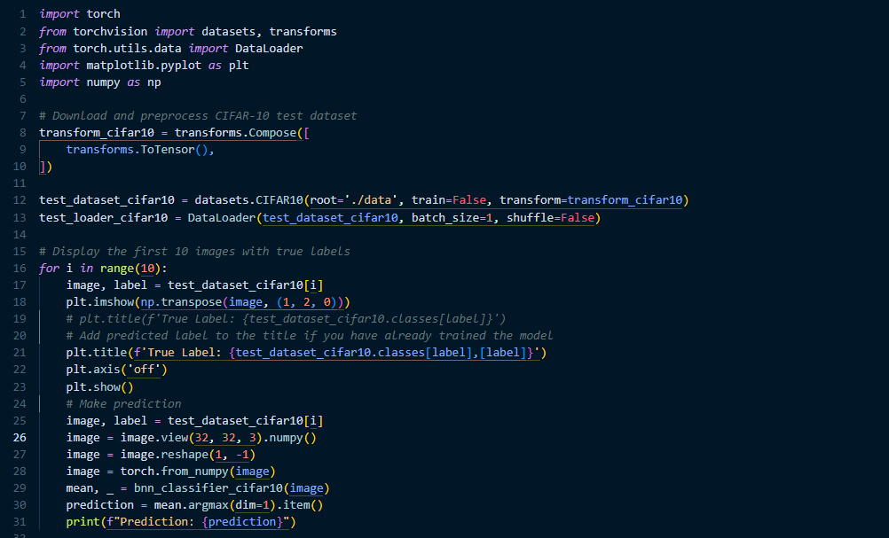
Displaying Output Based on CIFAR-10 Dataset

Slide 63
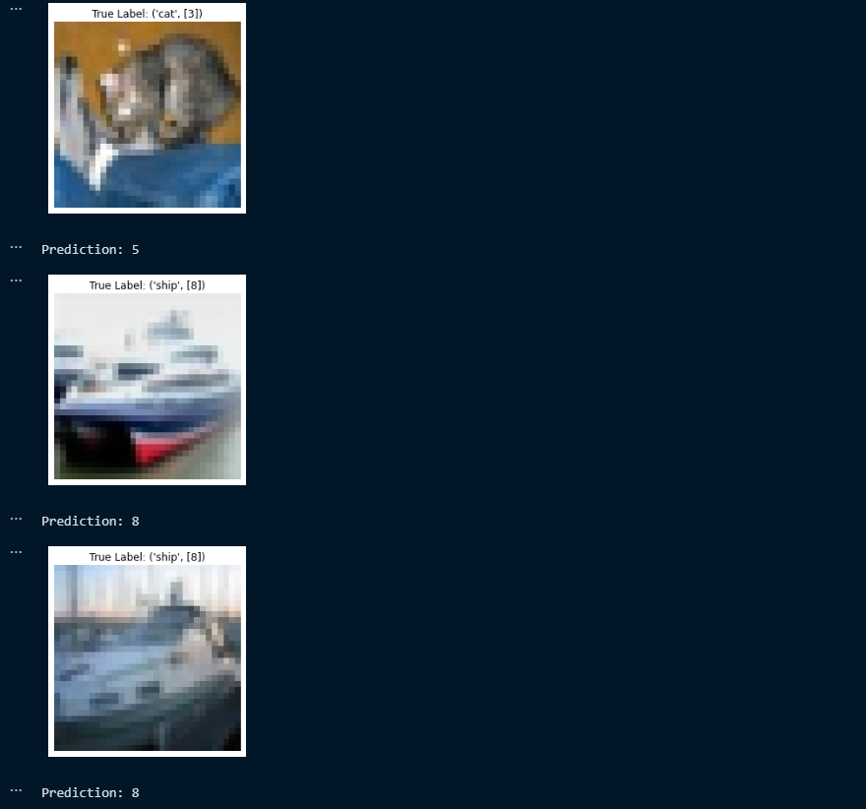
Output Based on CIFAR-10 Dataset

Slide 64
04
EDGE DETECTION USING BAYESIAN CNN

Slide 65
Edge detection using Bayesian Convolutional Neural Networks (CNNs) represents an innovative approach in computer vision for enhancing the accuracy and uncertainty estimation of edge detection tasks.
Traditional edge detection methods often provide binary outcomes, lacking a measure of confidence or uncertainty in the detected edges. Bayesian CNNs, on the other hand, integrate Bayesian principles into the convolutional neural network architecture, allowing for the modelling of uncertainty associated with the predictions.
In Bayesian CNNs, the model captures not only the most probable edge locations but also the uncertainty associated with these predictions. This is particularly valuable in real-world scenarios where noisy or ambiguous input data may lead to less confident predictions.
By incorporating Bayesian techniques, the model can express uncertainty in its predictions, providing a more comprehensive understanding of the reliability of detected edges.
The Bayesian edge detection process involves not only identifying edges but also estimating the probability distribution over possible edge locations.
This probabilistic perspective allows for more informed decision-making in applications where reliability and robustness are crucial, such as autonomous vehicles or medical image analysis.
Overall, edge detection using Bayesian CNNs represents a cutting-edge approach that addresses the limitations of traditional methods by offering not only accurate edge maps but also a quantification of uncertainty in the detected edges.

Slide 66
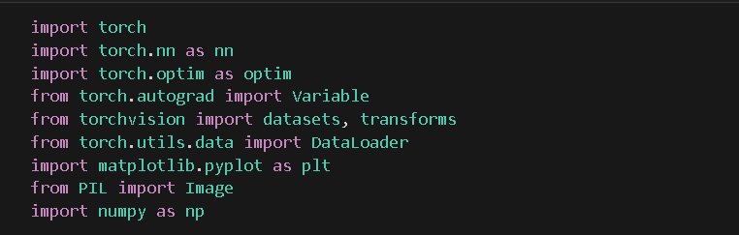

Slide 67
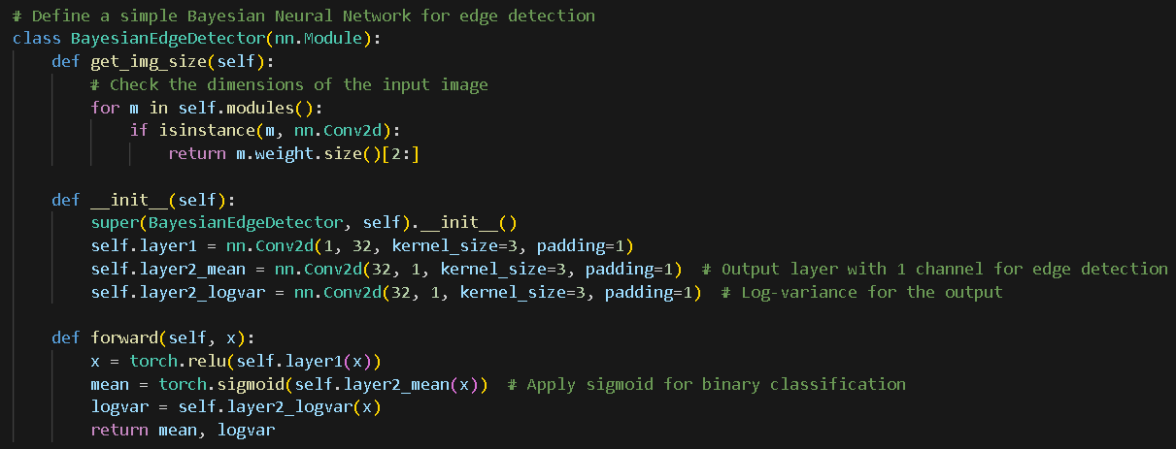

Slide 68
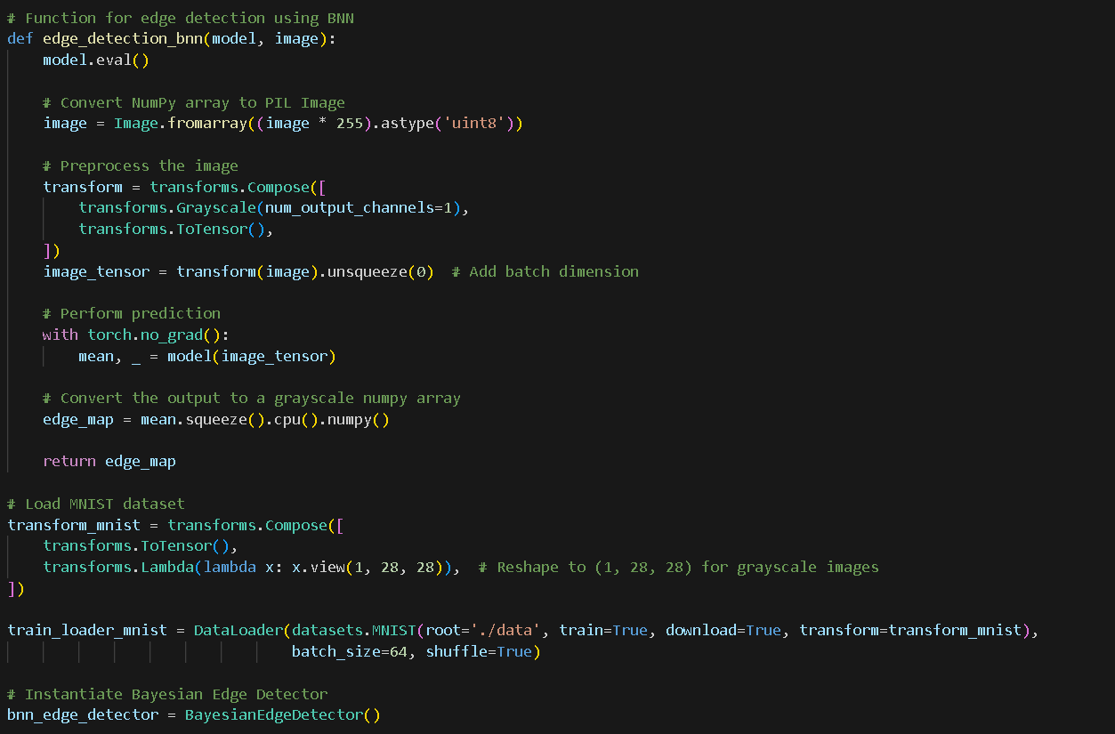

Slide 69
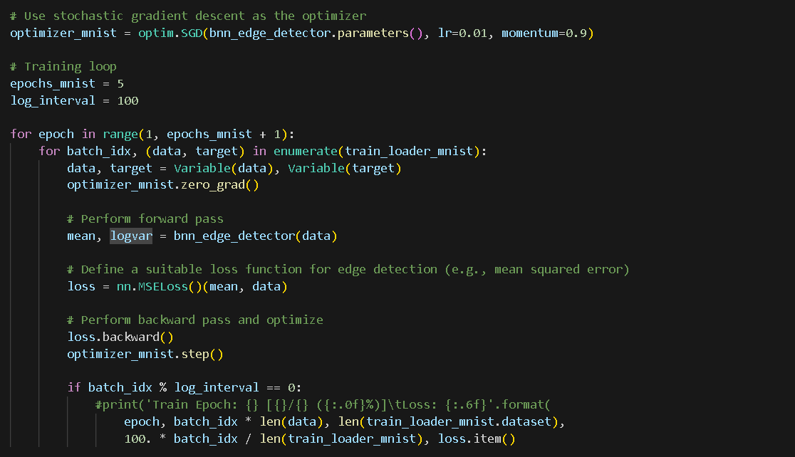

Slide 70
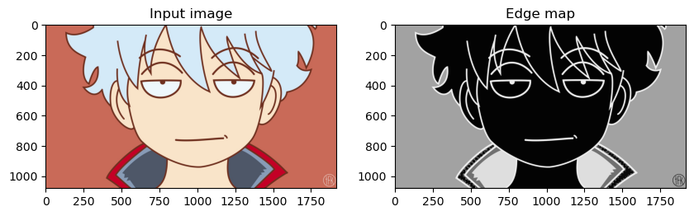
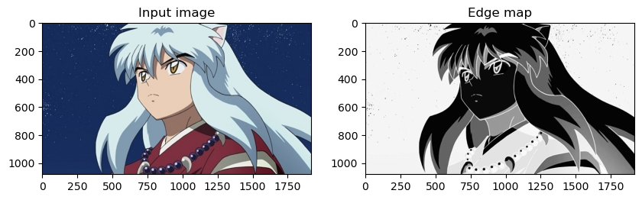

Slide 71
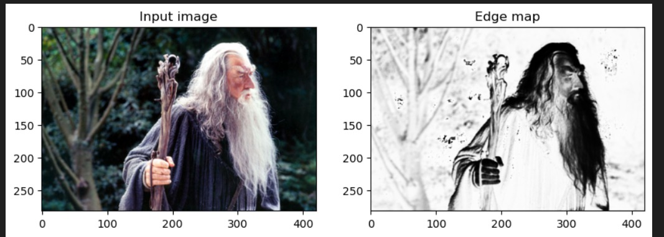

Slide 72
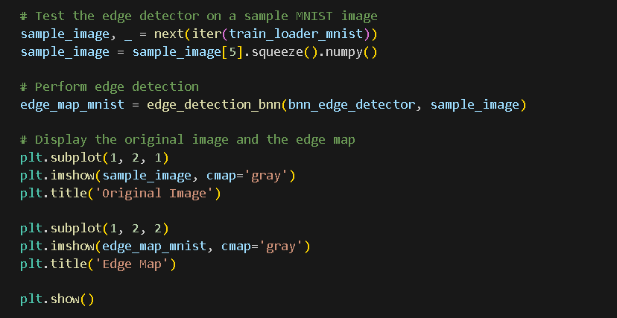
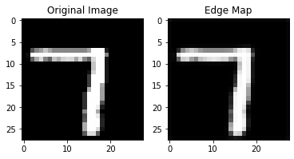

Slide 73
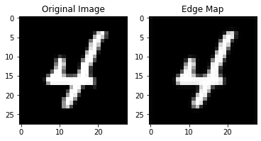
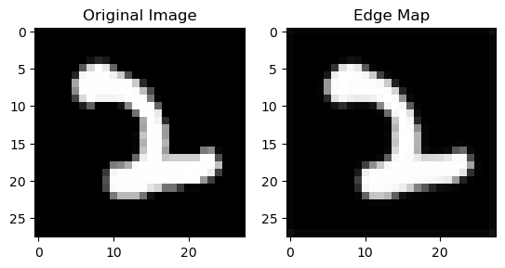
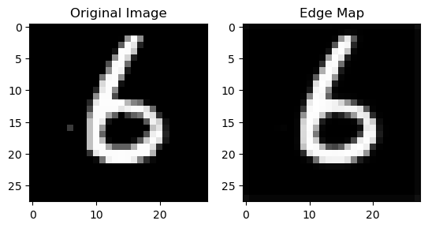
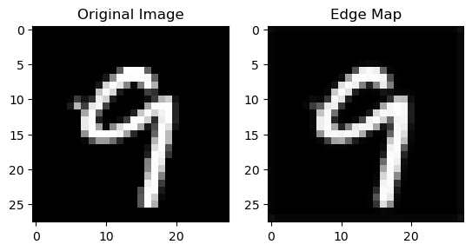

Slide 74
REFERENCES
https://towardsdatascience.com/from-theory-to-practice-with-bayesian-neural-network-using-python-9262b611b825
https://www.sciencedirect.com/science/article/abs/pii/S016794731930163X
1. F. Fang, L. Li, M. Rice and J. -H. Lim, "Towards Real-Time Crack Detection
Using a Deep Neural Network With a Bayesian Fusion Algorithm," 2019 IEEE
International Conference on Image Processing (ICIP), Taipei, Taiwan, 2019, pp.
2976-2980, doi: 10.1109/ICIP.2019.8803357.
2. K. Rahul-Vigneswaran, S. Sachin-Kumar, N. Mohan and K. P. Soman, "Dynamic
Mode Decomposition based feature for Image Classification," TENCON 2019 -
2019 IEEE Region 10 Conference (TENCON), Kochi, India, 2019, pp. 745-750,
doi: 10.1109/TENCON.2019.8929663.
3. Dutordoir, V., Wilk, M., Artemev, A. amp; Hensman, J.. (2020). Bayesian Image
Classification with Deep Convolutional Gaussian Processes. <i>Proceedings of the
Twenty Third International Conference on Artificial Intelligence and Statistics</i>,
in <i>Proceedings of Machine Learning Research</i> 108:1529-1539 Available
from https://proceedings.mlr.press/v108/dutordoir20a.html.

Slide 75
REFERENCES
4. https://arxiv.org/abs/1901.02731
5. Qadir, M. S., BİLGİN, G. (2023). Active learning with Bayesian CNN Using
the BALD Method for Hyperspectral Image Classification. Mesopotamian Journal
of Big Data, 2023, 53–60. https://doi.org/10.58496/MJBD/2023/008
6. F. Sultana, A. Sufian and P. Dutta, "Advancements in Image Classification using
Convolutional Neural Network," 2018 Fourth International Conference on Research
in Computational Intelligence and Communication Networks (ICRCICN), Kolkata,
India, 2018, pp. 122-129, doi: 10.1109/ICRCICN.2018.8718718.
7. Ramprasath, M., Anand, M. V., Hariharan, S. (2018). Image classification
using convolutional neural networks. International Journal of Pure and Applied
Mathematics, 119(17), 1307-1319.
8. Hossain, M. A., Sajib, M. S. A. (2019). Classification of image using convolutional neural network (CNN). Global Journal of Computer Science and Technology,
19(2).

